Slide 1
3.our Proposal

Slide 2
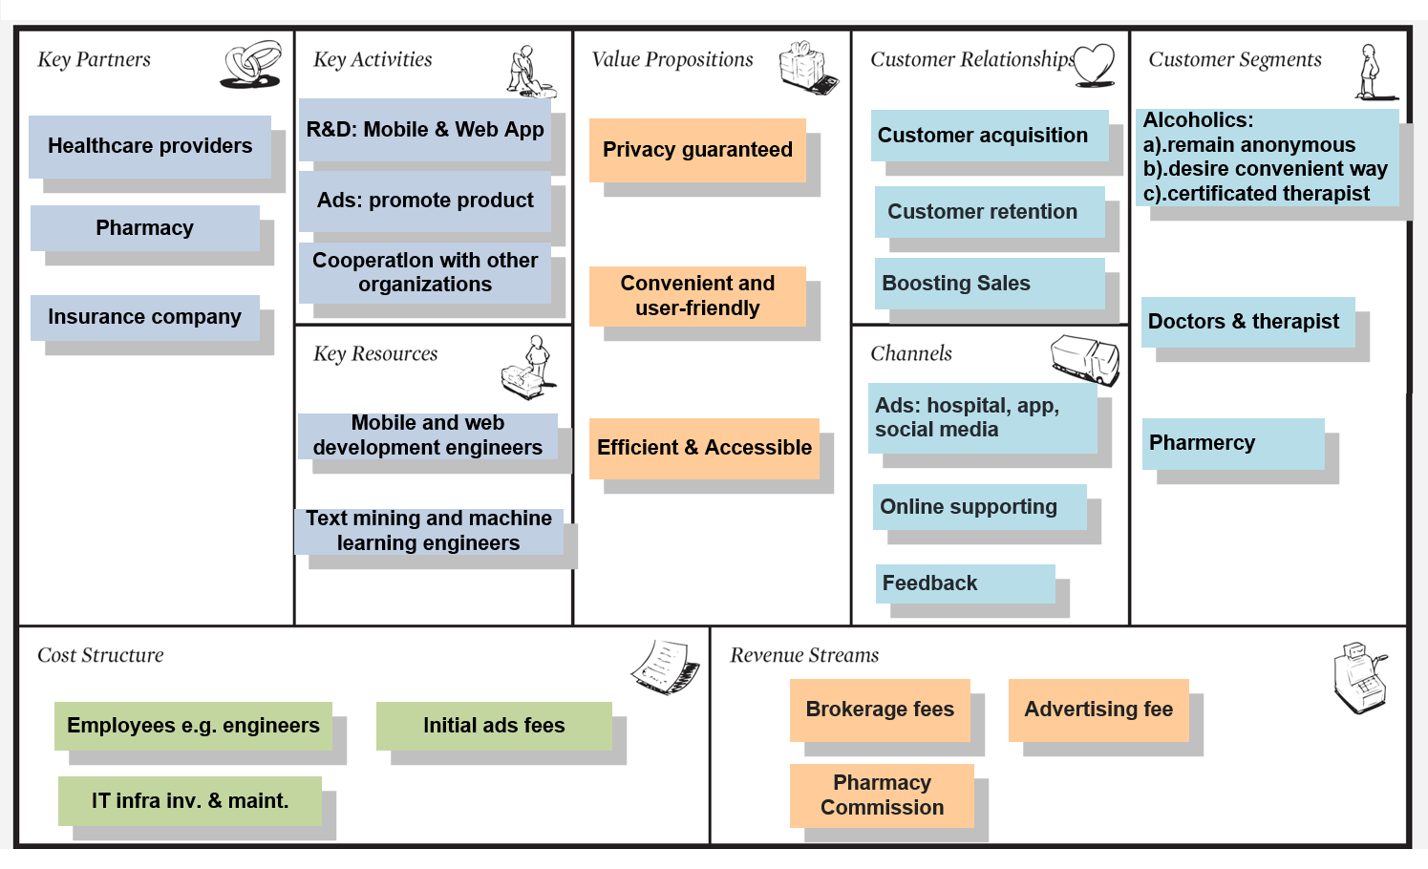
Business Model Canvas

Slide 3
Progress & Status
1. Team: Build our team and work together
2. Pain Point: identified, inefficient, cannot find certificated dcts
3. Value Proposition: privacy,efficient, user-friendly
3. Product(MVP): show the the 1st version of ASS (Web)
4. Busness Model: finished the 1st version of Business model
5. To do:
1. Go to the market:
2. Customer Validation:
3. Revised our business model:

